Slide 1
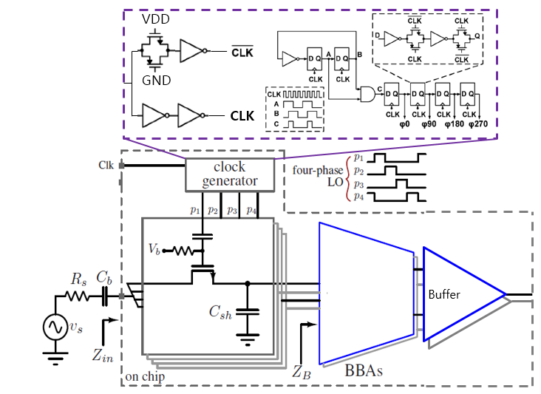
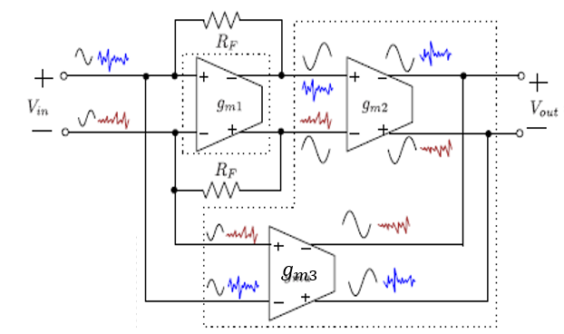
A Mixer-First Receiver with Noise-Canceling and Linear BBA
제목, 저자, 소속 등 논문 정보
Phuoc B. T. Huynh, Tae-Yeoul Yun
Department of Electronic and Computer Engineering, Hanyang University
Introduction
A0 사이즈, IDEC 템플릿 이용, 자유 레이아웃
A 4-path mixer-first receiver employs 25% duty cycle providing a better conversion loss and NF than the conventional passive switching mixer.
Mixer-first receiver can effectively selects the channel and reduces interferences by tuning LO frequency without the necessity of a bulky bandpass filter at the RF port.
The NC and linearity of the baseband amplifier (BBA) are enhanced to improve performances.
Circuit Design
서론
서술형 또는 요약형으로
2항목 이상
Fig. (a) shows the receiver architecture including:
  a 4-phase switching mixer
  a 4-phase clock generator
  a NC and linear BBA
  an output buffer for measurement
Fig. (b) shows the topology of NC and linear BBA where the mechanism to amplify the signal and cancel noise are illustrated.
본론
개념 및 기술, 회로 설계 및 제작, 칩 측정 결과 등 (예시)
구체적인 내용 작성
(a)
(b)
Result
Chip Photo
For 500-MHz RF signal, the mixer-first receiver achieves 32 dB of gain, 3.1 dB of NF.
The micro-photograph of mixer-first receiver realized in 28-nm process.
결론
서술형 또는 요약형으로
2항목 이상
Conclusion
Due to the limitation of the 4-phase digital clock generator, the mixer-first receiver can operate up to 4-GHz of RF signal input, and the inband (IB) and outband (OB) IIP3 are -4 and 29 respectively thanks to the linear BB.
Acknowledgements
The chip fabrication and EDA tool were supported by the IC Design Education Center(IDEC), Korea.

